Slide 1

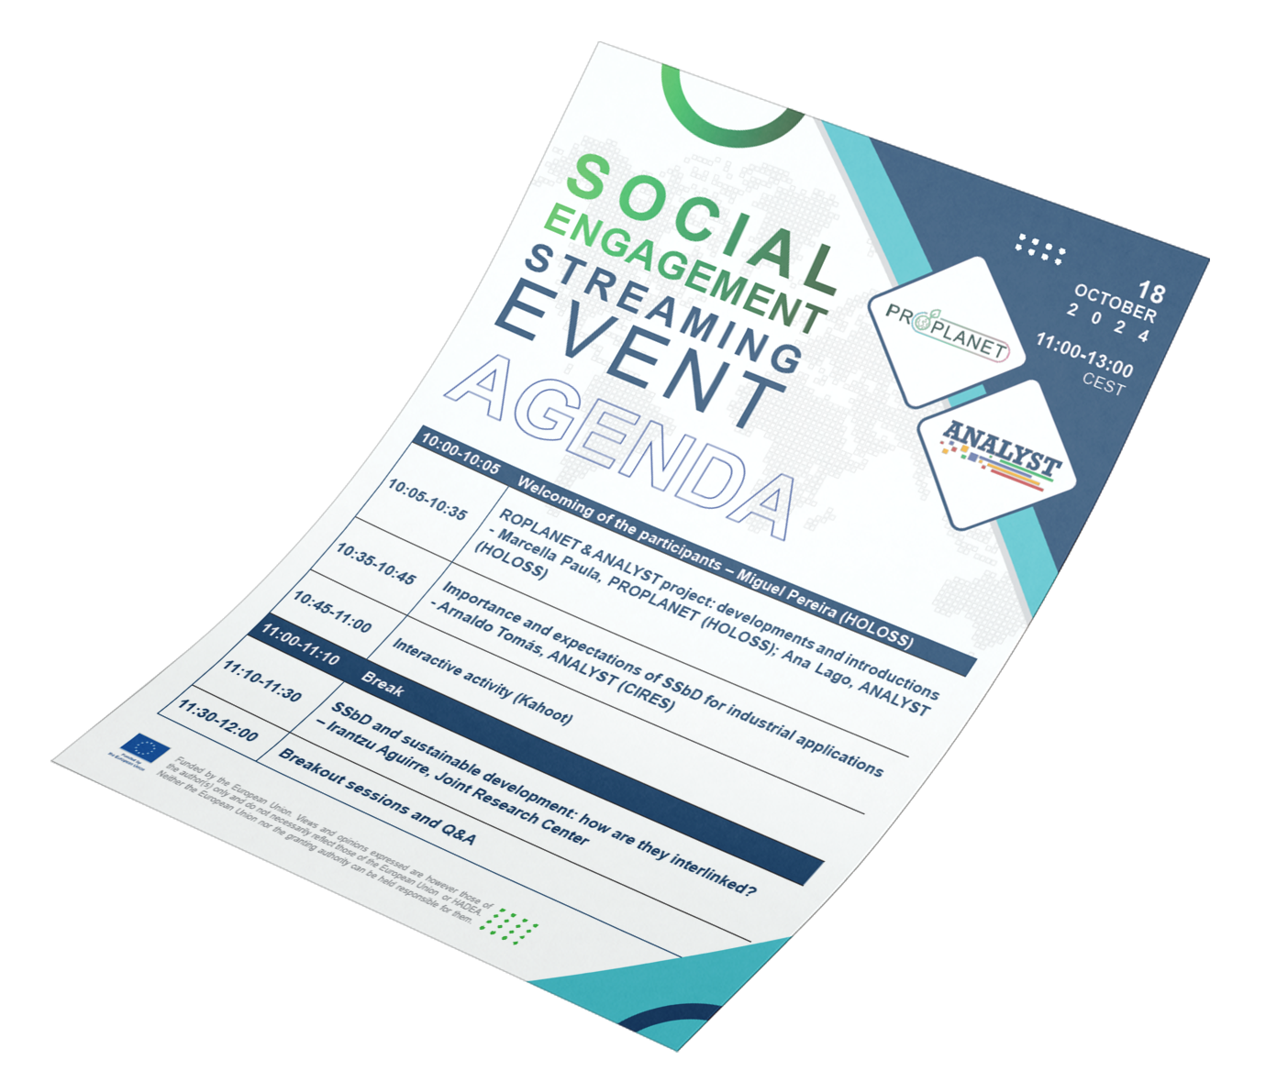
Social Engagement Agenda is out!

Slide 2
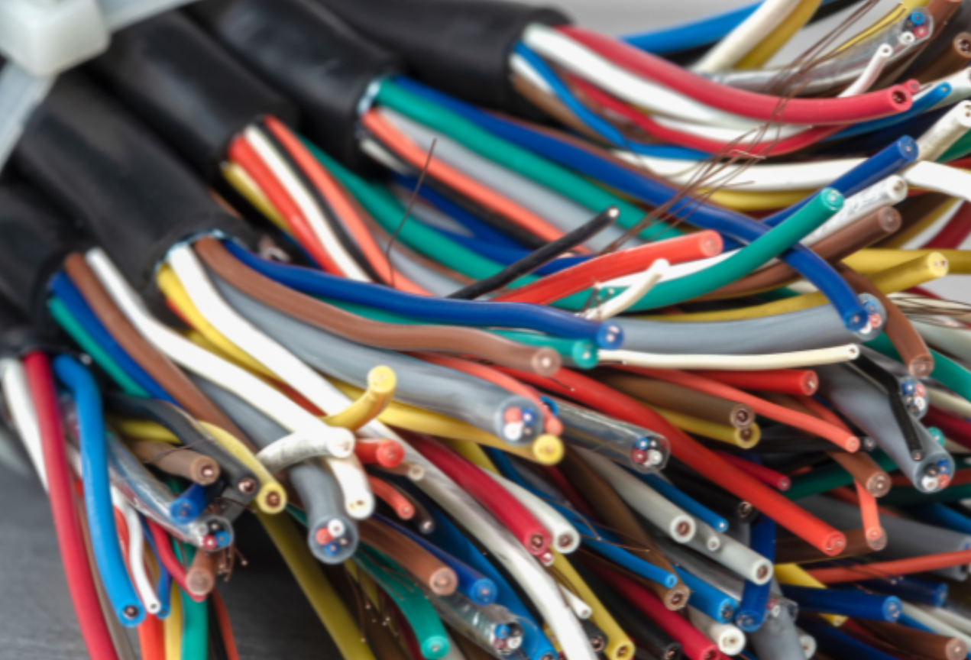



ANALYST
Project name: Strengthening the Integrated Approach of Holistic Impact Assessments for Safe and Sustainable by Design Plastic Value Chain
Project number: 101138548
1st JAN 2024 – 30th JUN 2027
ANALYST seeks to advance the shift to a safer and more sustainable industrial value chain by promoting knowledge of the safe and sustainable by design (SSbD) framework and enhancing understanding of sustainability trade-offs for inherently safe and sustainable chemicals, materials, and products.
ANALYST project will co-host with PROPLANET
the Social Engagement Streaming Event
On 18 October 2024, online, 11:00 – 13:00 CEST
www.analyst-project.eu
Notes:
Alternative template for text

Slide 3

Name
Title
Company
XXXXX
Notes:
Alternative template for text

